Slide 1


Lesson Study for VET - Teachers’ collaboration for
Improving the Quality of
Vocational Education and Training
2020-2023
2020-1-HU01-KA202-078848

Slide 2
Section break title
Dissemination Report
For the 2nd partner meeting
27 May 2021
LS4VET

Slide 3



Dissemination 1. - Formal
Implementation of the project’s website
in Drupal
With user friendly front-end
Containing basic information about the project available for the wide public
With the description of the partners with links to their sites
Giving information on the results and events as the project proceeds
LS4VET

Slide 4
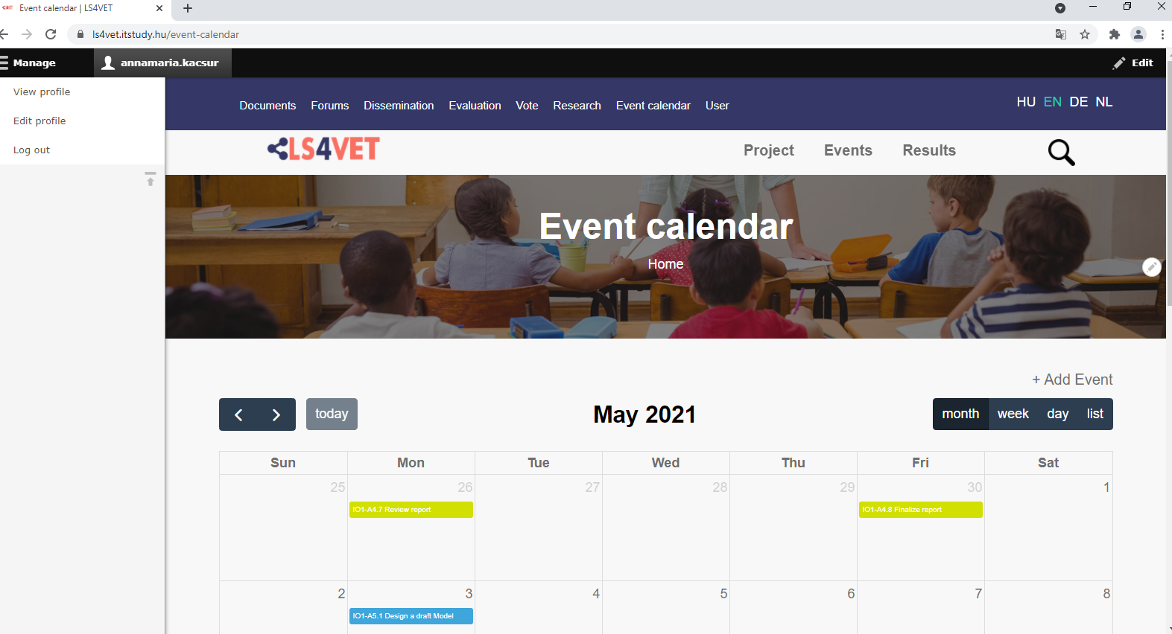
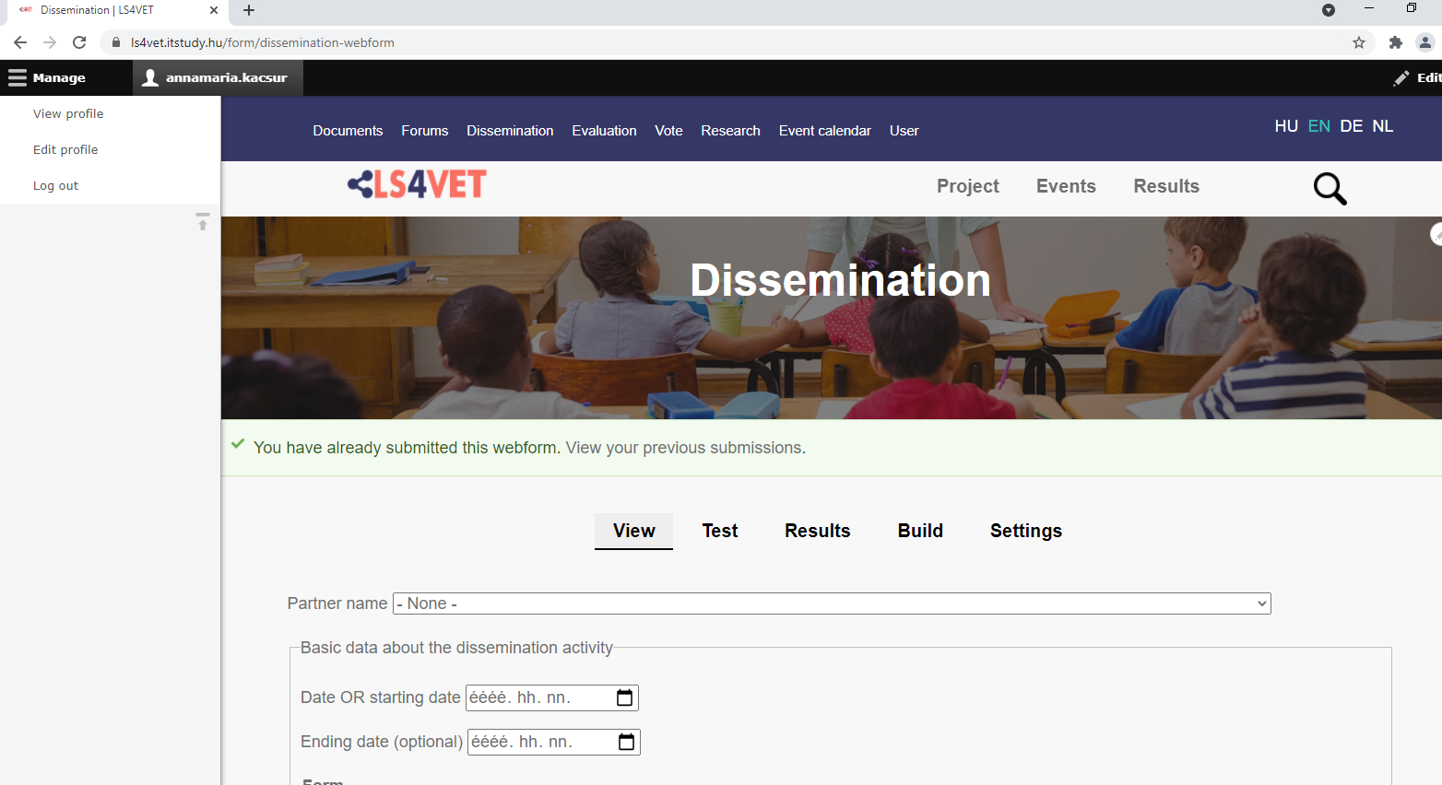
Collaboration site
With a document repository in the background (for authorized partners)
Functions for inner communication (Structured forum)
Dissemination webform to collect evidence
Event calendar
Dissemination 1. - Formal
Notification:
partners should be a bit more active in discussing project issues on the forum
LS4VET

Slide 5
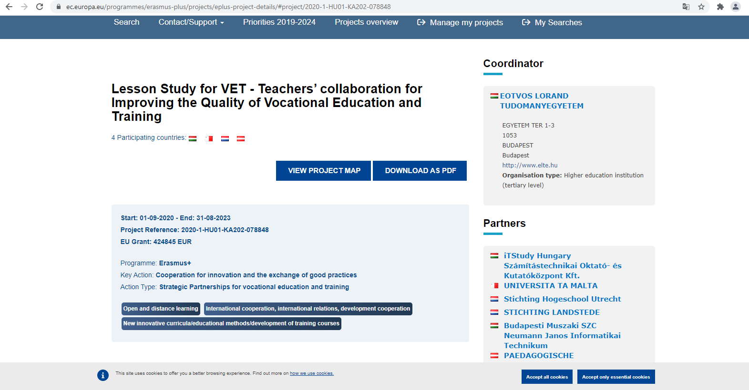
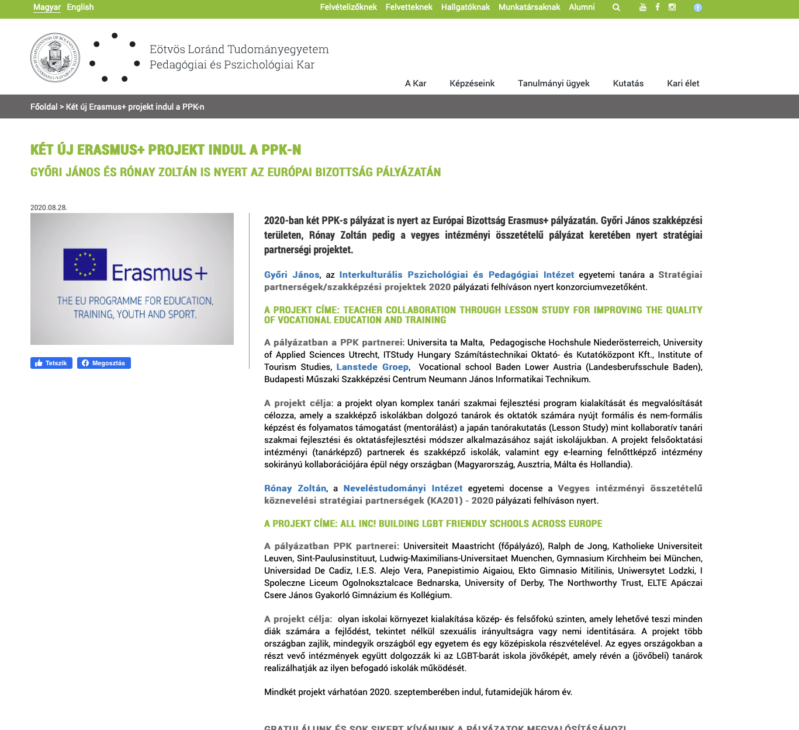

Publishing project information on EU Commission’s website
https://ec.europa.eu/programmes/erasmus-plus/projects/eplus-project-details/#project/2020-1-HU01-KA202-078848
Dissemination 1. – International
Publishing the project’s description
on all the partners’ websites
LS4VET

Slide 6
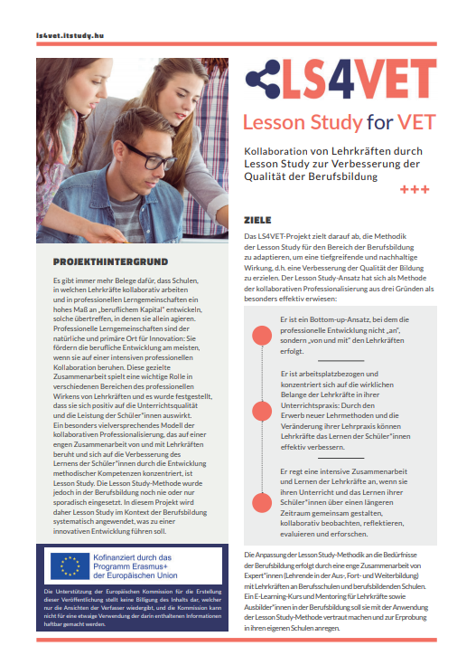

Dissemination 2. – national, regional, local
Project flyer for multiple use was completed in 4 languages
LS4VET

Slide 7
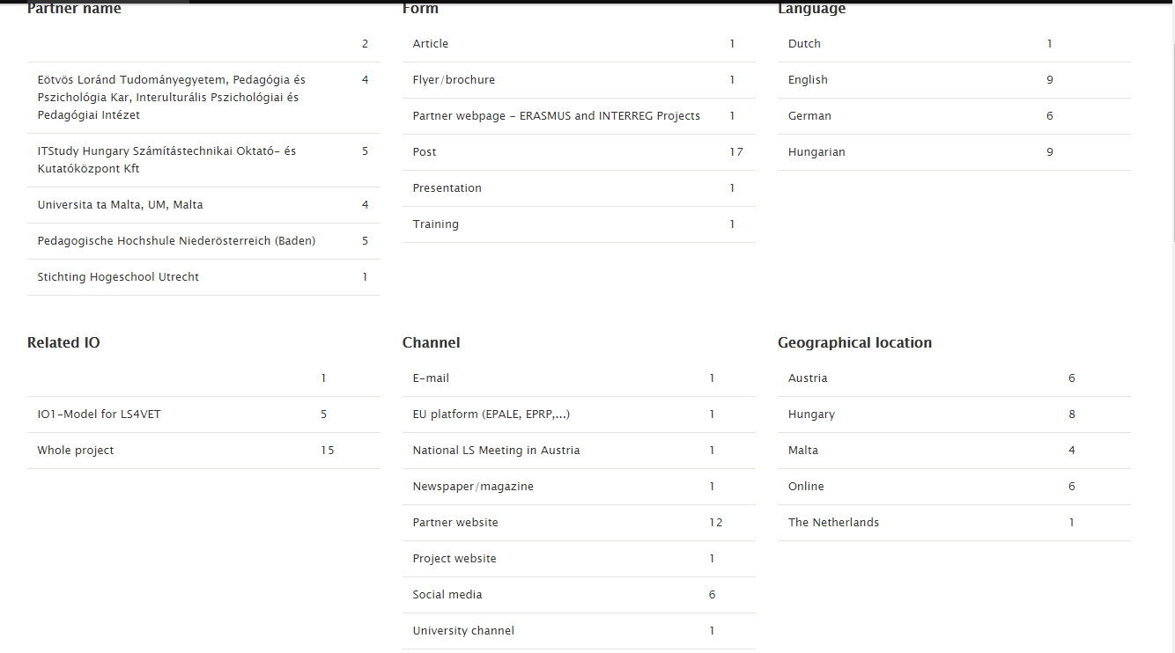
Dissemination 2. – national, regional, local
Notification: Some dissemination activities might not have been registered in the webform
LS4VET

Slide 8
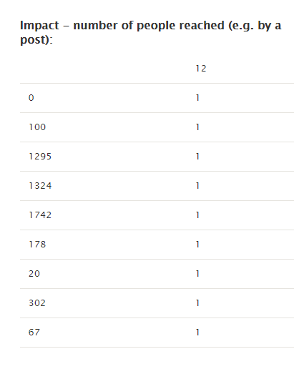
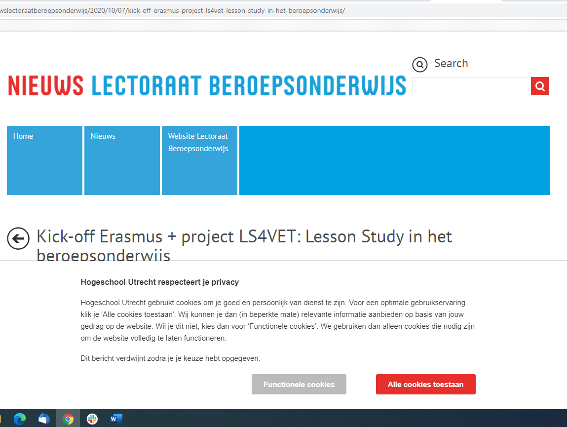

Dissemination 2. – national, regional, local
Most dissemination took place in social media and partners’ websites
The biggest impact (UM on Facebook) dissemination activity reached 1742 people
LS4VET

Slide 9

Dissemination 3 – Tasks due as IO1 closes
Summary & Newsletter – IO1 Model for LS4VET | EN | UAS | 05/2021
Author in English: UAS Topics Aim and conclusions of the survey identification of relevant VET-specific factors important details of the study by ELTE
Translation of IO summary and IO Newsletter | HU | ELTE
 | DE
 | NL
Publishing summary on the website and editing newsletter | EN, HU, DE, NL | iTStudy
Newsletter templates in 4 languages are available uploaded to the document templates on the collaboration platform!
Please, work in the Word template!
?
?
LS4VET

Slide 10
Dissemination 3 – Tasks due as IO1 closes
Project & Quality Management Handbook
LS4VET

Slide 11

Dissemination 3 – Take every possibility to share IO1 results
TIPS
Where?
Partner’s website
Academic journals
School magazines
Conferences
School or institutional events
Social media sites
Academic/professional websites
What?
Survey results in each country with conclusions
Details of the interviews’ summary
A post reporting that such a survey has been carried out
Factors taken into consideration when creating the model
How?
By sharing the 1st Newsletter
By creating posts based on its content
LS4VET

Slide 12

Project basics
Project coordinator
Title: Teachers’ Collaboration through Lesson Study for Improving the Quality of Vocational Education and Training
Acronym: LS4VET
Project ID: 2020-1-HU01-KA202-078848
Program: Erasmus+ KA2
Project Type: Strategic Partnership
Target group: teachers and trainers working in VET schools
Secondary target group: teacher educators and student teachers
Beneficiaries: VET students
Participant countries: Austria, Hungary, Malta, Netherlands
Project start: 1 September 2020
Project end: 31 August 2023
Project coordinator: ELTE - Faculty of Education and Psychology, Institute of Intercultural Psychology and Education
Project leader: Prof. Dr. János Győri
Project coordinator contact person: Eszter Bükki
Address: 23-27 Kazinczy u. Budapest 1075, Hungary
E-mail: ls4vet@ppk.elte.hu
Phone: + (36-1) 461-4500 / 3895
Partners
iTStudy Hungary Educational and Research Centre Ltd. (Hungary)
Neumann János Computer Science Technical School (Hungary)
Pedagogische Hochshule Niederösterreich (Austria)
Vocational School Baden Lower Austria (Austria)
Universita ta Malta (Malta)
Institute of Tourism Studies (Malta)
University of Applied Sciences Utrecht (Netherland)
Stichting Landstede (Netherland)
HTL Wiener Neustadt (Austria) – as associated partner to the project

Slide 13
Presented by …..
THANK YOU FOR WATCHING
LS4VET

