Slide 1
Lesson Study for VET - Teachers’ collaboration for Improving the Quality of Vocational Education and Training
2020-2023
2020-1-HU01-KA202-078848

Slide 2
Introducing the coordinator:
the ELTE team
Prof. Dr. János Győri
Eszter Bükki
Dr. Mónika Besenyei
LS4VET

Slide 3
EÖTVÖS LORÁND UNIVERSITY
ELTE is one of the oldest universities in Hungary – it was founded in 1635
public university
it is the largest and most popular higher education institution in Hungary
28,000 students
1,800 lecturers
8 faculties
110 doctoral programmes
LS4VET

Slide 4
Faculty of Education and Psychology
our faculty is: Faculty of Education and Psychology
a quite new faculty – since 2003
BA, MA (mostly MA) & doctoral programs in Hungarian and English in pedagogy, psychology, psychical education and recreation
on the other hand, it also instructs students from all faculties of the University in teacher training (pedagogy and psychology modules) and teachers’ in-service training (approximately 10 000 students altogether)
however: no vocational academic and/or vocational practice teacher education
it also coordinates R+D+I programmes in cooperation with other national and foreign HEIs, research institutions and practitioners
LS4VET

Slide 5
Institute of Education
Institute of Intercultural Psycholgy and Education
Institute of Education
BA in Pedagogy, MA in Educational Science & Doctoral School of Education programmes in education in Hungarian and English + teacher education and postgraduate training
Seven research groups, currently two national and six international research projects
Institute of Intercultural Psychology and Education
founded in 2005 as an organisational, educational and research centre, independent institute since 2015
currently two MA programmes (Teacher of Multicultural education and Intercultural psychology and pedagogy) and a specialisation in Interpersonal and Intercultural Psychology of the psychology MA programme; also offers 50-credit programmes "Interculturality, education and socialisation" and "Holocaust and social conflicts"
LS4VET

Slide 6
Doctoral School of Education
highly internationalized, mostly the EDiTE-program (European Doctorate in Teacher Education)
teachers’ learning
teachers’ professional development etc.
eg. teachers’ collaborative learning and development
Eszter and Mónika: Ph.D. students
János a supervisor of the doctoral school
LS4VET

Slide 7
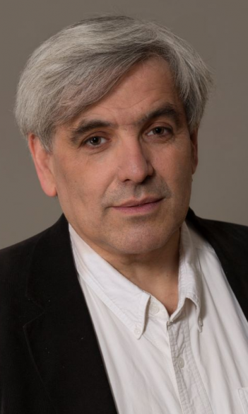
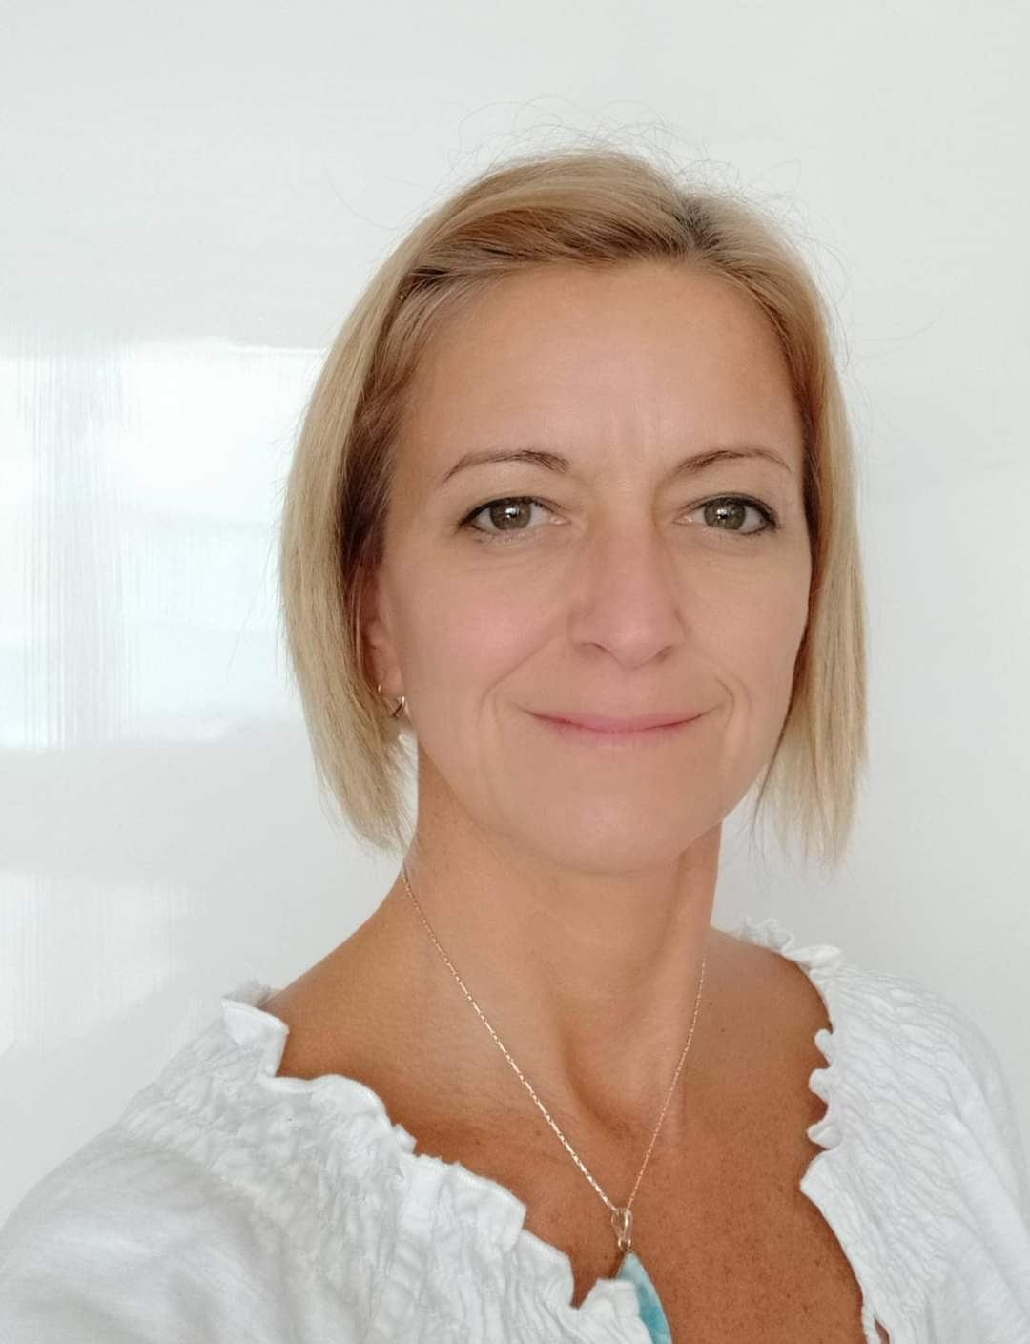
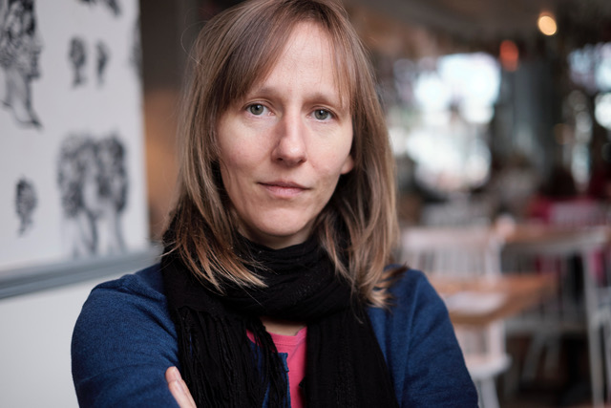
The ELTE LS4VET Team
Prof. dr. János Győri Eszter Bükki Dr. Mónika Besenyei
project leader project coordinator project assistant
LS4VET

Slide 8
János
professor of education
culture and education; multicultural/intercultural education
comparative education
East-Asian education
teacher education, knowledge building and professional development
lesson study
shadow education
gifted education and development especially in mathematics
subject teaching methodology
also a practicing teacher for 40 years
for 20 years parallel to my academic career
teacher of literature and grammar
supervisor teacher of appr. 200 student teachers in 30 years
LS4VET

Slide 9
Eszter
Worked in Cedefop and other European and national R&D projects in VET since 2005 – most importantly, Cedefop’s ReferNet programme (country and policy reports about VET in Hungary), also: VET financing, application of LO approach in general education and VET, graduate tracking
Currently working on her PhD dissertation at ELTE Doctoral School of Education about the professional learning and development of instructors in Hungarian VET schools
Also works as research assistant of a national-funded research project on teacher professional learning and development (MoTeL) at ELTE Institute of Education
Background: MAs in Philosophy and in History, lived abroad (UK, RO, RU) for 8 years
LS4VET

Slide 10
Mónika
Project management practices in EU funded capacity building and knowledge share projects (Leonardo LLP, EMAS8Country, EMAS Easy)
Researcher, university lecturer, trainer in the field of sustainable development, mentor and curriculum developer in continuing education program of the education system of the Hungarian public administrators
Registered adult training expert and adult training program specialist
Currently working for the Hungarian Central Statistical Office, and for the Institute of Public Administration Training of the National University of Public Service
Doing her PhD. on shadow education
Mathematics and physics teacher (MA), environmental (BA) engineer, PhD in business and management – Sustainable development specialist
LS4VET

Slide 11
WHAT DOES ELTE BRING TO ?
a massive knowledge on LS
strong activity in its international professional context
a massive knowledge on VET and its international aspects
a strong collaboration with VET institutions
the combination of high creativity and practical focus
a well prepared project support office in the background

Slide 12
ELTE’s expectations from
a strong international collaboration in the combined field of LS 4 VET
learning from others
learning by inspiring others
a strong improvement of LS in Hungary
a strong impact on teachers’ professional development in vocational education in Hungary
improvement of teachers’ learning and CPD issues and practice in Hungary
to prepare ELTE Faculty of Education and Psychology to serve in the future as
national centre of LS research and practice
in international nod in the net of LS and VET CPD

Slide 13
A short state of art of LS in Hungary
one central academic person of the field (János) with authentic knowledge of the method and with wide international relationships
still: starting phase; not a well designed and developed system
many presentations, in-service teacher training programs
but few experience in pratice (however: also in vocational educational institution)
a number of vocational teachers know about the method but not familiar with its practice

Slide 14
THANK YOU FOR WATCHING!
LS4VET

Slide 15
Project basics
Project coordinator
Title: Teachers’ Collaboration through Lesson Study for Improving the Quality of Vocational Education and Training
Acronym: LS4VET
Project ID: 2020-1-HU01-KA202-078848
Program: Erasmus+ KA2
Project Type: Strategic Partnership
Target group: teachers and trainers working in VET schools
Secondary target group: teacher educators and student teachers
Beneficiaries: VET students
Participant countries: Austria, Hungary, Malta, Netherlands
Project start: 1 September 2020
Project end: 31 August 2023
Project coordinator: ELTE - Faculty of Education and Psychology, Institute of Intercultural Psychology and Education
Project leader: Prof. Dr. János Győri
Project coordinator: Eszter Bükki
Address: 23-27 Kazinczy u. Budapest 1075, Hungary
E-mail: ls4vet@ppk.elte.hu
Phone: + (36-1) 461-4500 / 3895
Partners
iTStudy Hungary Educational and Research Centre Ltd. (Hungary)
Neumann János Computer Science Technical School (Hungary)
Pedagogische Hochshule Niederösterreich (Austria)
Vocational School Baden Lower Austria (Austria)
Universita ta Malta (Malta)
Institute of Tourism Studies (Malta)
University of Applied Sciences Utrecht (Netherland)
Stichting Landstede (Netherland)

